Slide 1



DEPARTMENT OF COMPUTER SCIENCE & ENGINEERING
Domain Winter Winning Camp 2023
Subject Name:Database Management System
Day: 3
Topics Covered: Joins and Views
DISCOVER . LEARN . EMPOWER

Slide 2
These points related to Day wise topic should be included :
Prerequisite of topic : SQL, Aggregate functions, Creating User, Creating Roles
Objective: To understand joins and views in RDBMS.
Outcome: Implement queries of joins and views on two or more than two tables.

Slide 3
SQL Joins
SQL Join is used to fetch data from two or more tables, which is joined to appear as single set of data.
It is used for combining column from two or more tables by using values common to both tables.
JOIN Keyword is used in SQL queries for joining two or more tables.
A SQL Join statement is used to combine data or rows from two or more tables based on a common field between them.
Minimum required condition for joining table, is (n-1) where n, is number of tables. A table can also join to itself, which is known as, Self Join.

Slide 4
HOW TO JOIN TWO TABLES IN SQL?
A JOIN works on two or more tables if they have at least one common field and have a relationship between them.
JOIN keeps the base tables unchanged.
A SQL Join clause is put within a Select statement and at the end, it’s given a join condition, which tells the database how to fetch your data.
The column specified within the join condition must be preceded by a table name if the column name is the same in both tables.
When a column is preceded with a table name, it’s known as a qualified column.

Slide 5
Types of SQL JOIN
The are two types of SQL JOINS - EQUI JOIN and NON EQUI JOIN
1) SQL EQUI JOIN :
The SQL EQUI JOIN is a simple SQL join uses the equal sign(=) as the comparison operator for the condition. It has two types - SQL Outer join and SQL Inner join.
2) SQL NON EQUI JOIN :
The SQL NON EQUI JOIN is a join uses comparison operator other than the equal sign like >, <, >=, <= with the condition.

Slide 6
In order to perform a JOIN query, the required information we need are:
a) The name of the tables b) Name of the columns of two or more tables, based on which a condition will perform.
Syntax:
FROM table1 join_type table2 [ON (join_condition)]

Slide 7
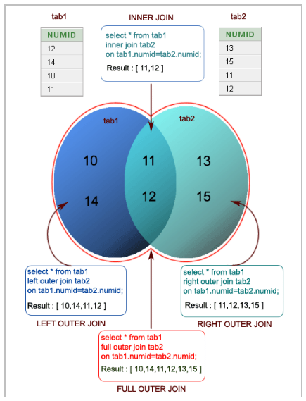
Pictorial Presentation of SQL Joins:

Slide 8
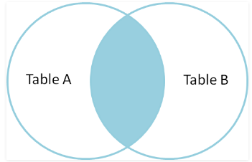
TYPES OF JOIN
INNER JOIN : The INNER JOIN keyword selects all rows from both the tables as long as the condition satisfies. This keyword will create the result-set by combining all rows from both the tables where the condition satisfies i.e value of the common field will be same.
SELECT table1.column1,table1.column2,table2.column1,.... FROM table1 INNER JOIN table2 ON table1.matching_column = table2.matching_column;
table1: First table. table2: Second table matching_column: Column common to both the tables.

Slide 9
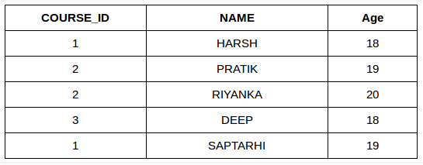
Example
SELECT StudentCourse.COURSE_ID, Student.NAME, Student.AGE FROM Student INNER JOIN StudentCourse ON Student.ROLL_NO = StudentCourse.ROLL_NO;

Slide 10
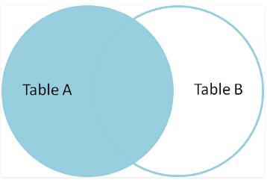
LEFT JOIN
This join returns all the rows of the table on the left side of the join and matching rows for the table on the right side of join. The rows for which there is no matching row on right side, the result-set will contain null. LEFT JOIN is also known as LEFT OUTER JOIN.
SELECT table1.column1,table1.column2,table2.column1,.... FROM table1 LEFT JOIN table2 ON table1.matching_column = table2.matching_column;
table1: First table. table2: Second table matching_column: Column common to both the tables.

Slide 11
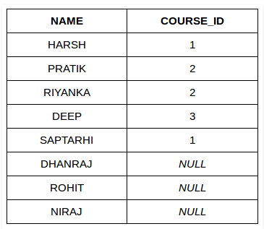
Example
SELECT Student.NAME,StudentCourse.COURSE_ID FROM Student LEFT JOIN StudentCourse ON StudentCourse.ROLL_NO = Student.ROLL_NO;

Slide 12
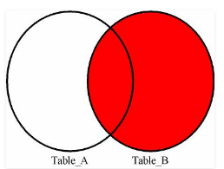
RIGHT JOIN
RIGHT JOIN is similar to LEFT JOIN. This join returns all the rows of the table on the right side of the join and matching rows for the table on the left side of join. The rows for which there is no matching row on left side, the result-set will contain null. RIGHT JOIN is also known as RIGHT OUTER JOIN.
SELECT table1.column1,table1.column2,table2.column1,.... FROM table1 RIGHT JOIN table2 ON table1.matching_column = table2.matching_column;
table1: First table. table2: Second table matching_column: Column common to both the tables.

Slide 13
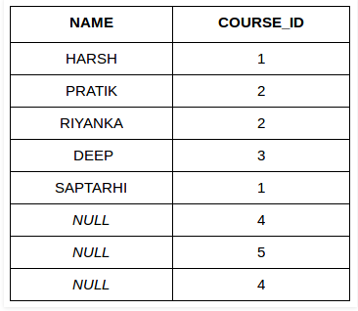
Example
SELECT Student.NAME,StudentCourse.COURSE_ID FROM Student RIGHT JOIN StudentCourse ON StudentCourse.ROLL_NO = Student.ROLL_NO;

Slide 14
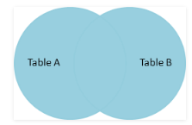
FULL JOIN
FULL JOIN creates the result-set by combining result of both LEFT JOIN and RIGHT JOIN. The result-set will contain all the rows from both the tables. The rows for which there is no matching, the result-set will contain NULL values.
SELECT table1.column1,table1.column2,table2.column1,.... FROM table1 FULL JOIN table2 ON table1.matching_column = table2.matching_column;
table1: First table. table2: Second table matching_column: Column common to both the tables.

Slide 15
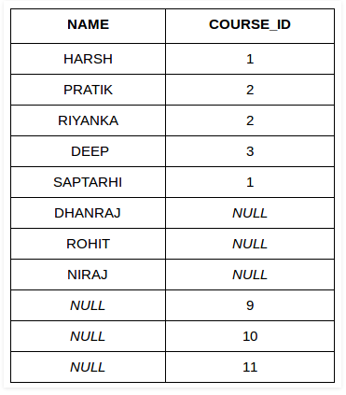
Example
SELECT Student.NAME,StudentCourse.COURSE_ID FROM Student FULL JOIN StudentCourse ON StudentCourse.ROLL_NO = Student.ROLL_NO;

Slide 16
CROSS JOIN
In a CARTESIAN JOIN there is a join for each row of one table to every row of another table.
This usually happens when the matching column or WHERE condition is not specified.
Cross join is similar to an inner join where the join-condition will always evaluate to True.
SELECT table1.column1 , table1.column2, table2.column1... FROM table1 CROSS JOIN table2;
Example: In the below query we will select NAME and Age from Student table and COURSE_ID from StudentCourse table.

Slide 17
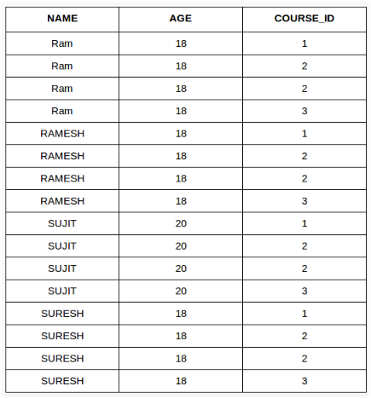
Example
In the output you can see that each row of the table Student is joined with every row of the table StudentCourse.
SELECT Student.NAME, Student.AGE, StudentCourse.COURSE_ID FROM Student CROSS JOIN StudentCourse;

Slide 18
EQUI JOIN
SQL EQUI JOIN performs a JOIN against equality or matching column(s) values of the associated tables. An equal sign (=) is used as comparison operator in the where clause to refer equality.
You may also perform EQUI JOIN by using JOIN keyword followed by ON keyword and then specifying names of the columns along with their associated tables to check equality.
SELECT column_list FROM table1, table2....
WHERE table1.column_name =
table2.column_name;

Slide 19
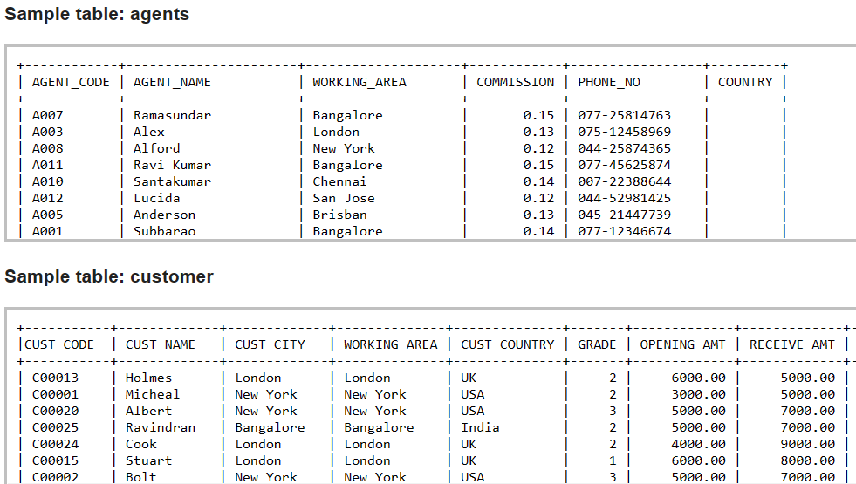
Example of EQUI JOIN

Slide 20
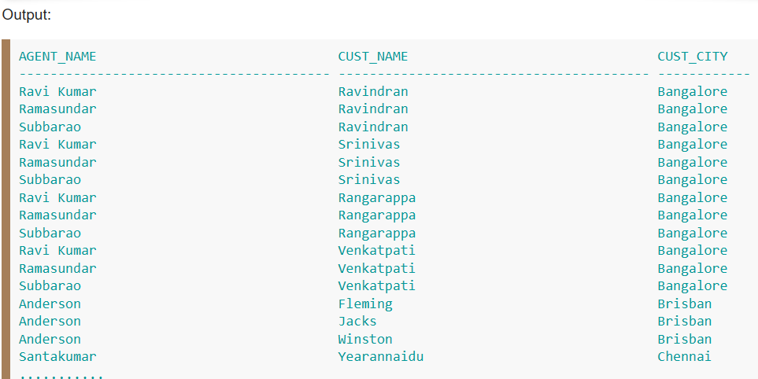
Example of EQUI JOIN
SELECT agents.agent_name,customer.cust_name,customer.cust_city FROM agents,customer
WHERE agents.working_area=customer.cust_city;

Slide 21
SELF JOIN
As the name signifies, in SELF JOIN a table is joined to itself.
That is, each row of the table is joined with itself and all other rows depending on some conditions.
In other words we can say that it is a join between two copies of the same table.
SELECT a.coulmn1 , b.column2 FROM table_name a, table_name b WHERE some_condition;
table_name: Name of the table. some_condition: Condition for selecting the rows.
SELECT a.ROLL_NO , b.NAME FROM Student a, Student b WHERE a.ROLL_NO < b.ROLL_NO;

Slide 22
Natural Join
The SQL NATURAL JOIN is a type of EQUI JOIN and is structured in such a way that, columns with the same name of associated tables will appear once only.
The associated tables have one or more pairs of identically named columns. - The columns must be the same data type. - Don’t use ON clause in a natural join.

Slide 23
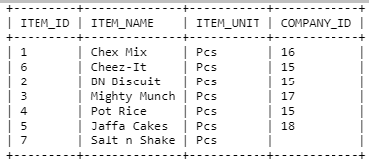
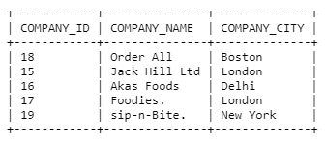
Syntax
SELECT * FROM table1 NATURAL JOIN table2;
Example
Sample table: foods and company
SELECT * FROM foods NATURAL JOIN company;

Slide 24
Unique constraint
The UNIQUE constraint ensures that all values in a column are different.
Both the UNIQUE and PRIMARY KEY constraints provide a guarantee for uniqueness for a column or set of columns.
A PRIMARY KEY constraint automatically has a UNIQUE constraint.
ALTER TABLE Persons ADD UNIQUE (ID);
CREATE TABLE Persons (
ID int NOT NULL UNIQUE,
LastName varchar(255) NOT NULL,
FirstName varchar(255),
Age int
);

Slide 25
Default Constraint
The DEFAULT Constraint is used to fill a column with a default and fixed value. The value will be added to all new records when no other value is provided.
Using DEFAULT on CREATE TABLE :
Syntax :
CREATE TABLE tablename (
Columnname DEFAULT 'defaultvalue' );
DROP a DEFAULT Constraint :
ALTER TABLE tablename
ALTER COLUMN columnname
DROP DEFAULT;
.

Slide 26
Views
• A view is like a “virtual” table.
• Defined by a query, which describes how to compute the view contents on the fly
View is the result set of stored query.
Read-only vs. updatable views.
• DBMS stores the view definition query instead of view contents
• Can be used in queries just like a regular table

Slide 27
Views
A view is the result set of a stored query on the data, which the database users can query just as they would in a persistent database collection object.
This pre-established query command is kept in the database dictionary.
Unlike ordinary base tables in a relational database, a view does not form part of the physical schema: as a result set, it is a virtual table computed or collated dynamically from data in the database when access to that view is requested.
Changes applied to the data in a relevant underlying table are reflected in the data shown in subsequent invocations of the view.

Slide 28
Read-only and Updatable
If the database system can determine the reverse mapping from the view schema to the schema of the underlying base tables, then the view is updatable.
INSERT, UPDATE, and DELETE operations can be performed on updatable views.
Read-only views do not support such operations because the DBMS cannot map the changes to the underlying base tables.
A view update is done by key preservation.

Slide 29
Creating and dropping views
Example: members of Jessica’s Circle
CREATE VIEW JessicaCircle AS SELECT * FROM User WHERE uid IN (SELECT uid FROM Member WHERE gid = 'jes');
• Tables used in defining a view are called “base tables”
• User and Member above
• To drop a view
DROP VIEW JessicaCircle ;

Slide 30
Using views in queries
Example: find the average popularity of members in Jessica’s Circle
SELECT AVG(pop) FROM JessicaCircle ;
• To process the query, replace the reference to the view by its definition
• SELECT AVG(pop) FROM (SELECT * FROM User WHERE uid IN (SELECT uid FROM Member WHERE gid = 'jes')) AS JessicaCircle ;

Slide 31
Why use views?
To hide data from users
To hide complexity from users
Logical data independence
If applications deal with views, we can change the underlying schema without affecting applications
Recall physical data independence: change the physical organization of data without affecting applications
To provide a uniform interface for different implementations or sources
Real database applications use tons of views

Slide 32
Modifying views
Does it even make sense, since views are virtual?
• It does make sense if we want users to really see views as tables
• Goal: modify the base tables such that the modification would appear to have been accomplished on the view

Slide 33
A simple case
CREATE VIEW UserPop AS SELECT uid, pop FROM User;
DELETE FROM UserPop WHERE uid = 123;
translates to:
DELETE FROM User WHERE uid = 123;

Slide 34
An impossible case
CREATE VIEW PopularUser AS SELECT uid, pop FROM User WHERE pop >= 0.8;
INSERT INTO PopularUser VALUES(987, 0.3);
• No matter what we do on User, the inserted row will not be in PopularUser

Slide 35
A case with too many possibilities
CREATE VIEW AveragePop(pop) AS SELECT AVG(pop) FROM User;
• Note that you can rename columns in view definition UPDATE AveragePop SET pop = 0.5;
• Set everybody’s pop to 0.5?
• Adjust everybody’s pop by the same amount?
• Just lower Jessica’s pop ?

Slide 36
Example(1)
A view is equivalent to its source query. When queries are run against views, the query is modified. For example, if there exists a view named accounts_view with the content as follows:
accounts_view:
SELECT name, money_received, money_sent, (money_received - money_sent)
AS balance, address, ...
FROM table_customers c
JOIN accounts_table a
ON a.customer_id = c.customer_id

Slide 37
Example(2)
The application could run a simple query such as:
Simple query
SELECT name, balance FROM accounts_view;
The RDBMS then takes the simple query, replaces the equivalent view, then sends the following to the query optimizer

Slide 38
Example(3)
Preprocessed query:
SELECT name, balance
FROM (SELECT name, money_received, money_sent, (money_received - money_sent)
AS balance, address, ...
FROM table_customers c
JOIN accounts_table a
ON a.customer_id = c.customer_id )

Slide 39
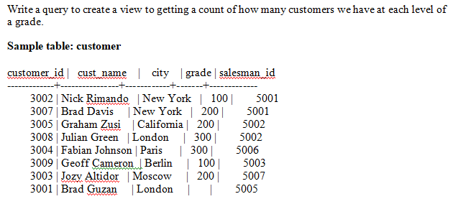
Practice Question

Slide 40
Interview questions
Use of Joins in SQL.
Define View
Queries (self join , inner join)
Discuss Joins in sql
What is Join in DBMS?
Explain types of joins
Explain cross product of two tables in SQL
Write one query demonstrating equi join.

Slide 41
Reference for further reading
http://www.sql-join.com/sql-join-types
https://www.techonthenet.com/sql/joins.php
https://www.tutorialspoint.com/sql/sql-using-joins.htm
https://www.dofactory.com/sql/join
https://nptel.ac.in/courses/106/106/106106220/
https://www.tutorialspoint.com/sql/sql-using-views.htm
https://www.coursehero.com/file/p6l8nup/A-view-is-like-a-virtual-table-Defined-by-a-query-which-describes-how-to/

Slide 42
Thank you

